Slide 1
Context Free Grammars
Shakir Ullah Shah

Slide 2
Example
    S→aSa | aBa
    B→bB | b
First production builds equal number of a’s on both sides and recursion is terminated by S→aBa
Recursion of B→bB may add any number of b’s and terminates with B→b
L(G) = {a^{n}b^{m}a^{n} n>0, m>0}

Slide 3
Example
Consider the following CFG ∑ = {a, b}
  S → aXb | bXa | Λ
  X → aX | bX | Λ
The above CFG generates the language of strings, defined over ∑ ={a,b}, beginning and ending in different letters OR including Λ as well.

Slide 4
Examples
A grammar that generates the language consisting of even-length string over {a, b}
S → aO | bO | Λ
O → aS | bS
G1: S→AB
A→aA | a
B→bB | Λ
And
G2: S→ aS | aB
B→bB | Λ
Both generates a⁺b*

Slide 5
Even-Even
Devise a grammar that generates strings with even number of a’s and even number of b’s
We can use the strategy of previous example i.e. non-terminal represents the current states of the derived string
The non-terminals with interpretations are:
  Non-Terminal Interpetation
  S Even a’s and Even b’s
  A Even a’s and Odd b’s
  B Odd a’s and Even b’s
  C Odd a’s and Odd b’s

Slide 6
Even-Even contd.
The grammar will be
S → aB | bA | Λ
A → aC | bS
B → aS | bC
C → aA | bB
When S is present, the derived string satisfies the Even-Even condition as S → Λ
Construct a CFG over {a, b} generating all strings that do not contain abc?

Slide 7
Remarks
We have seen that some regular languages can be generated by CFGs, and some non-regular languages can also be generated by CFGs.
ALL regular languages can be generated by CFGs.
There is some non-regular language that cannot be generated by any CFG.
Thus, the set of languages generated by CFGs is properly larger than the set of regular languages, but properly smaller than the set of all possible languages.

Slide 8
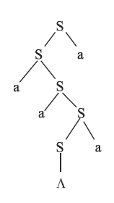
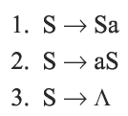
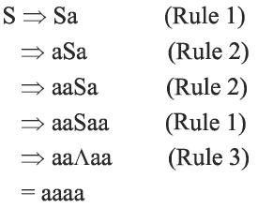
Parse Tree
We can use a tree diagram to show that derivation process:
We start with the starting symbol S. Every time we use a production to replace a nonterminal by a string, we draw downward lines from the nonterminal to EACH character in the string.
Tree diagrams are also called syntax trees, parse trees, generation trees, production trees, or derivation trees.

Slide 9

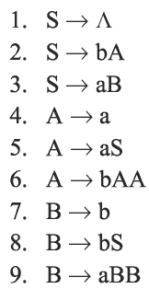
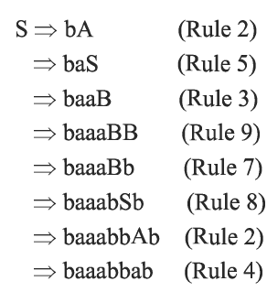
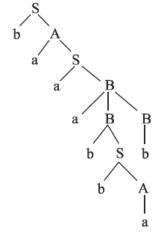
Notes:
S bA
baA
baS

Slide 10
Ambiguity
A CFG is called ambiguous if there is one word it generates which has two different parse trees.
If a CFG is not ambiguous, it is called unambiguous.

Slide 11
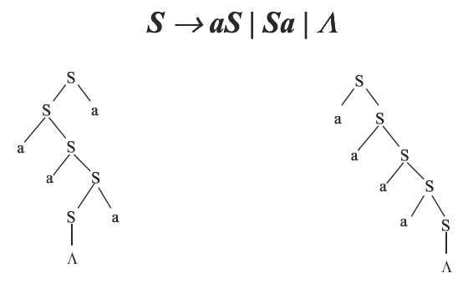

Ambiguity

Slide 12
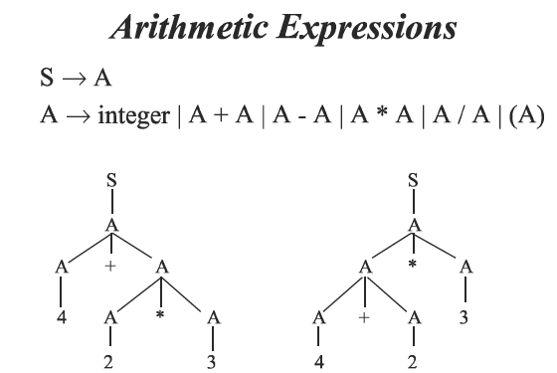

Notes:
E=expression
T=Term

Slide 13
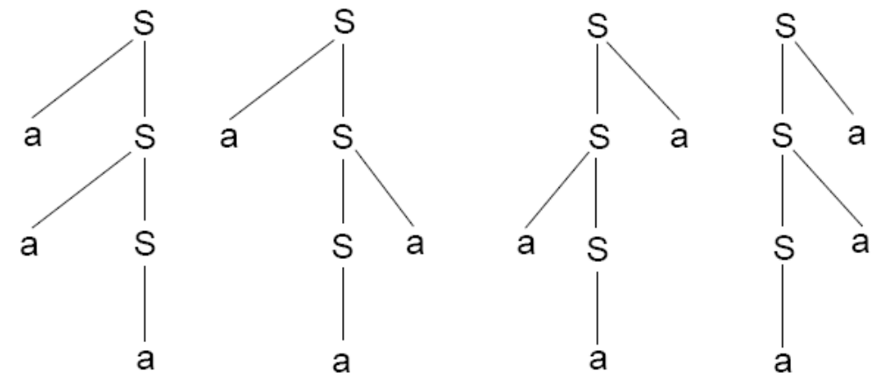
Ambiguity- example
The following CFG defines the language of all non-null strings of a’s:
S → aS| Sa |a
The word a³ can be generated by 4 different trees:

Slide 14
Ambiguity- example
Consider the language generated by the following CFG:
S → AB
A → a
B → b
There are two derivations of the word ab:
S => AB => aB => ab
or S => AB => Ab => ab

Slide 15
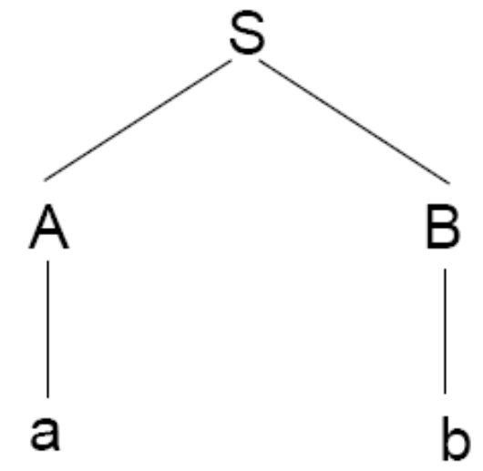
However, These two derivations correspond to the same syntax tree:
The word ab is therefore not ambiguous. In general, when all the possible derivation trees are the same for a given word, then the word is unambiguous.

Slide 16
Derivation
Leftmost derivation
  If at each step in a derivation a production is applied to leftmost variable, then derivation is said to be leftmost
Rightmost derivation
  If at each step in a derivation a production is applied to rightmost variable, then derivation is said to be rightmost

Slide 17
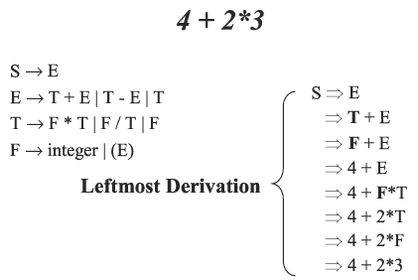

Slide 18
